Slide 1
Gambling with Lives Broadening the Basis of AFINet
Liz Katis & Jim Orford, on behalf of Gambling with Lives To be presented at: Addiction & the Family International Network (AFINet): 1st International Conference, Newcastle upon Tyne, UK, Session 7, 11.10 -12.00, Sunday 11th November 2018

Slide 2
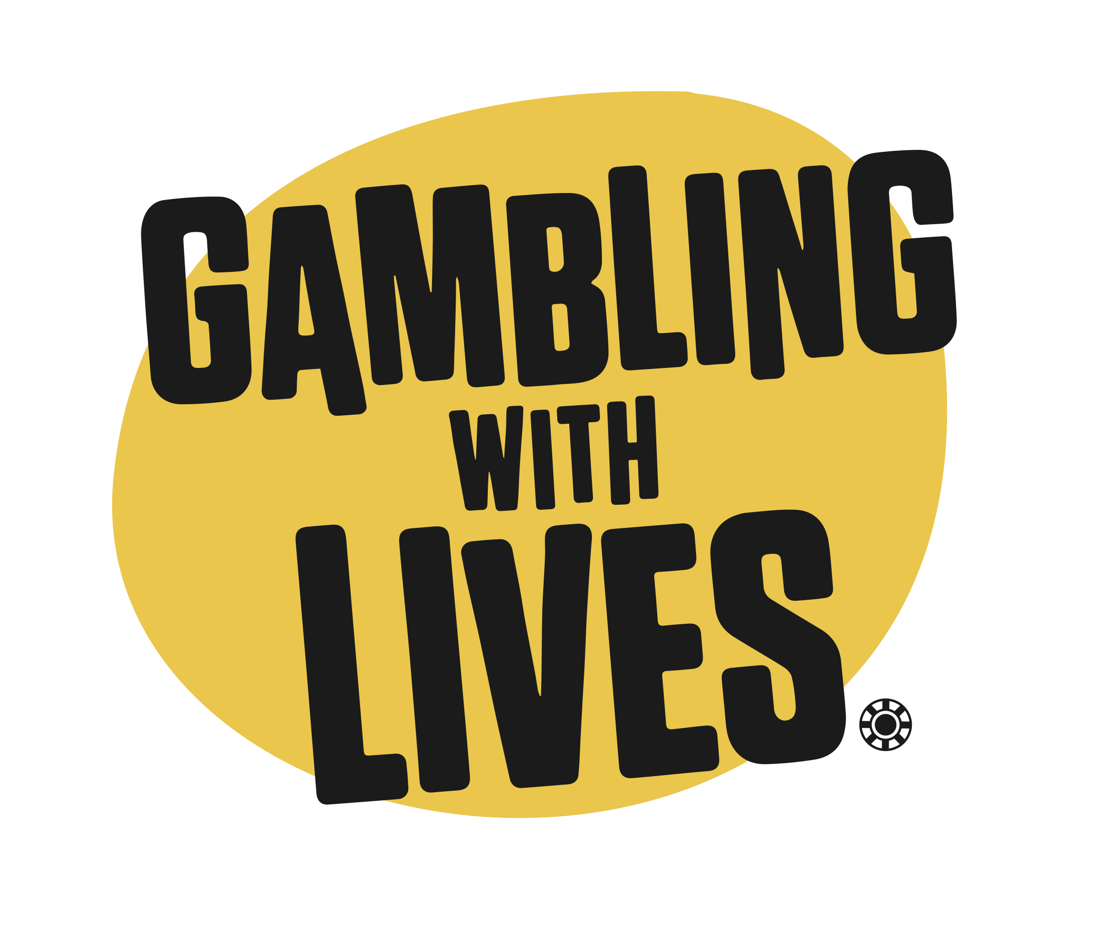
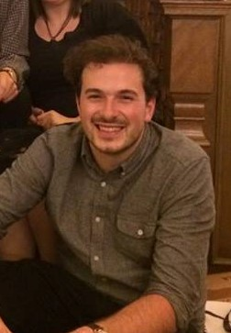
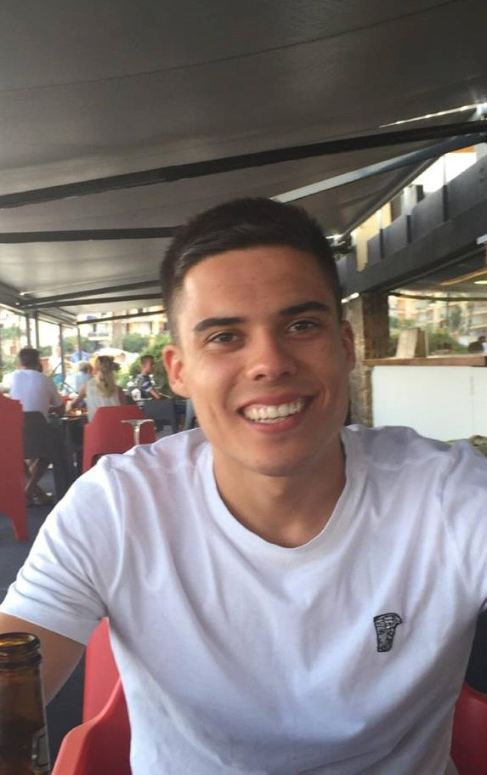
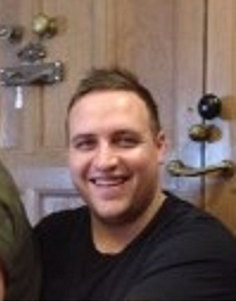
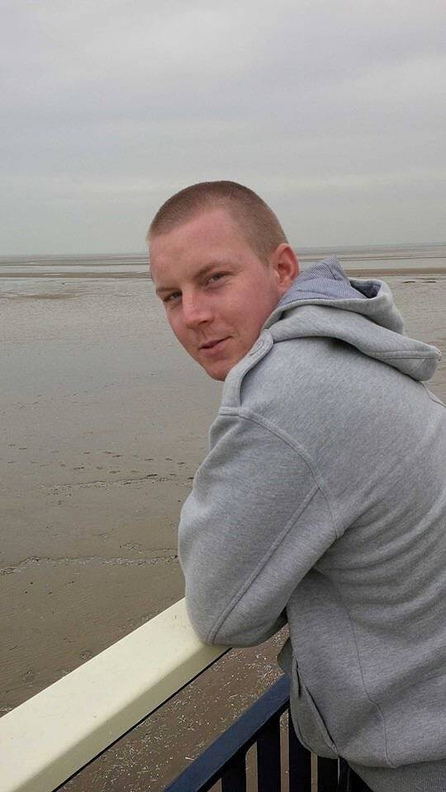
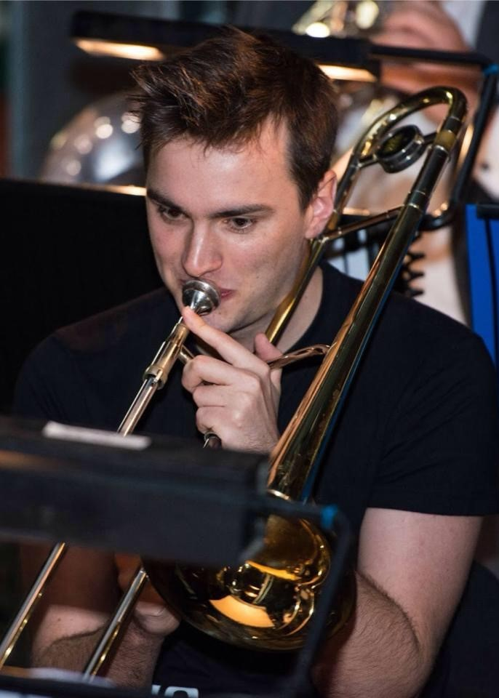
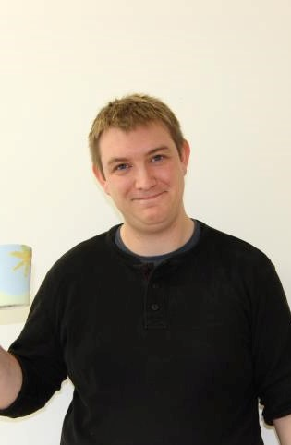
Set up by families bereaved by gambling related suicides to:
Raise awareness of the suicide risk of gambling;
Campaign for tougher regulation of the industry;
Campaign for hugely expanded treatment for addicts and support for families, integrated with the NHS
Jack (age 24) Chris (age 25) Daniel (age 35) Ryan (age 27) Joshua (age 23) Phil (age 30)

Slide 3
Gambling with Lives experience challenges the popular model of gambling addiction – co-morbidity, “the same as alcohol and drugs”, focus on finance
Normal, bright, happy, popular, high functioning young men from close loving families – gambling was their only problem
Deaths were not the result of gambling debt
All started young (underage) – FOBTs and arcade games
Many had been ‘clear’ of gambling for months at a time – and were deliberately re-targeted by the industry
Deaths were very sudden – ‘out of the blue’
Failed by the treatment network
We and they were failed by a lack of a public health warning … gambling is a complex and potentially fatal addiction

Slide 4
There are 430,000 adult gambling addicts in the UK, with a further 2 million “at risk”
25,000 young people aged 11-16 are addicted to gambling
Gambling is the hidden addiction … but gambling suicide is invisible
More hidden than other addictions – no obvious physical signs
Gambling addicts are 3 - 4 times more likely to attempt to kill themselves than other types of addict
Research in the UK and Hong Kong found that 4-11% of suicides were related to gambling ... equivalent to 250-650 deaths p.a. in the UK
Severity defined as equivalent to drug and alcohol in 2013 (DSM V)
Intermittent addiction – often free for months then relapse
Severe and sudden risk particularly on relapse
FOBTs and online casino and slot games particularly addictive and correlated with suicide risk

Slide 5
Family members campaign
For the inclusion of family members in their relatives’ treatment
For more help for affected family members in their own right
For improved professional training about addiction and its effects on families
For better consideration for family members bereaved as a result of addiction
For legislation that recognises the contribution and rights of family members affected by addiction
For more and better treatment for addiction
For greater awareness amongst local or state representatives about how national policy is putting people at risk
Against new local outlets or concentration of outlets for the sale of addictive products; the sale or promotion of addictive products to children or young people; or addiction-relevant local criminal activity

Slide 6
Thoughts for AFINet
Affected family members may need help and support but ALSO want to campaign
Many may ONLY want to campaign
Does AFINet have anything to offer these groups?
Should the basis of AFINet be broader than it is?

Slide 7
Liz & Charles Ritchie www.gamblingwithlives.org info@gamblingwithlives.org 07864 299158
Jack Chris Daniel Ryan Joshua Phil

